Slide 1




Proposal for whole set of Fidelity Prime Catalytic Converter and Front Muffler
November 2023
ایران دلکو در اندیشه آسمانی آبی...

Slide 2
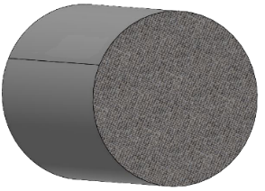
Substrate Change
Name | Substrate Specification according to drawing and sample |  |  | Substrate Specification of Iran Delco's suggestion
 | Diameter (mm) | Length (mm) | Cell Specification (CPSI/Mil) | Diameter (mm) | Length (mm) | Cell Specification (CPSI/Mil)
Fidelity Pre Catalyst | Ø105.7 | 152.4 | 600/3 | - | - | -
Fidelity Main Catalyst | Ø118.4 | 100 | 400/6 | - | - | -
Dignity Prestige Catalyst |  | 152.4 | 750/3 | - | - | -
Dignity Prime Front Substarte |  | 64 | 600/6 | Ø118.4 | 64 | 600/4
Dignity Prime Rear Substarte |  | 100 | 400/6 | - | - | -
1

Slide 3
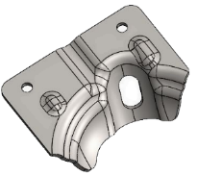
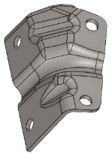
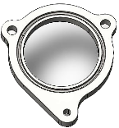
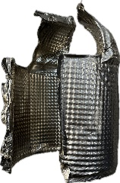
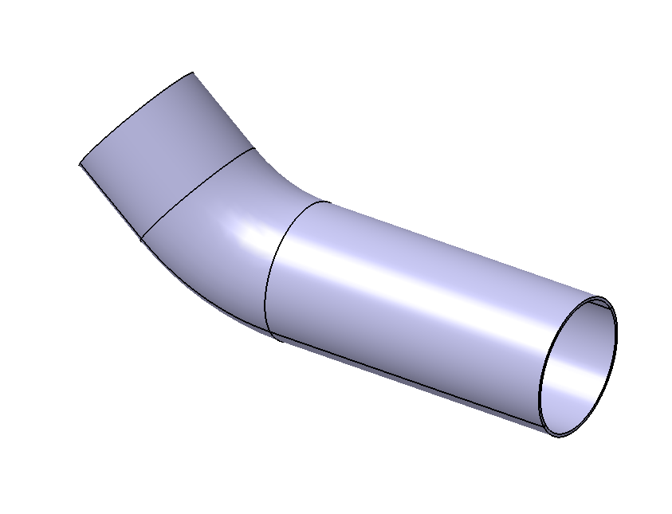
Material Changes
Raw | Part name | Material according to customer's drawing | Iran Delco suggestion | Picture | Reason
1 | Bracket | SUS 409L,T=4mm | SUS 430,T=4mm |  | OEM materials in these parts are not available in Iran, and It is not possible to supply in the short time due to limitation for minimum order amount of material.
 |  | EN10088-2 | EN10088-2
2 | Bracket | SUS 409L,T=4mm | SUS 430,T=4mm
 |  | EN10088-2 | EN10088-2
3 | Intake flange | SUS 410,T=10mm | SUS 304L,T=10mm
 |  | EN10088-2 | EN10088-2
4 | Head shield | SUS 430,T=0.15mm | Emboss SUS 304,T=0.25-0.3mm
 |  | EN10088-2 | or SUS 409L,T=0.6mm
5 | Intake and outlet pipe of down pipe ASSY | SUS 409L, Ø55 T=1.2mm | SUS 409L, Ø54 T=1.5mm
 |  | EN10088-2 | EN10088-2
2

Slide 4
Material Changes
Comparison mechanical and chemical characteristics between stainless steel SUS 409L and SUS 430
Comparison chemical characteristics
Grade | C | Si | Mn | P | S | Cr
SUS 409L(1.4512) | 0.03 | 1 | 1 | 0.04 | 0.015 | 10.5 to 12.5
SUS 430(1.4016) | 0.08 | 1 | 1 | 0.04 | 0.015 | 16 to 18
According to EN10088-2 standard
Regarding chemical characteristics which you can find in the upper table, the Chromium ingredient of SUS 430 is bigger than SUS409L. In this way, the SUS430 has better corrosion and heat resistance.
3

Slide 5
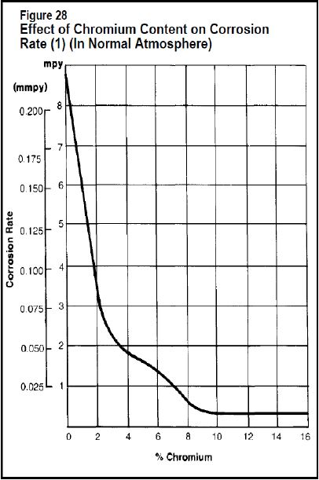
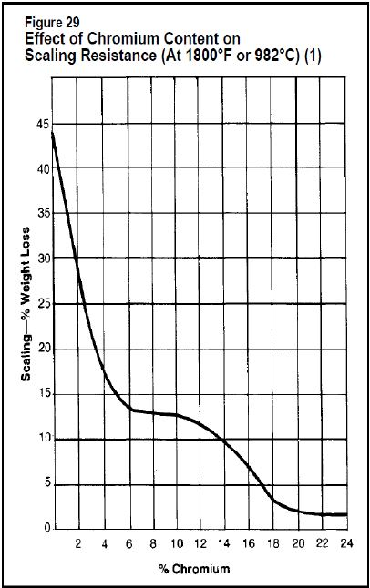
Material Changes
Comparison mechanical and chemical characteristics between stainless steel SUS 409L and SUS 430
Comparison corrosion resistance
Chromium percentage to corrosion rate
Regarding the upper charts, if the Chromium ingredient increases, the corrosion resistance will increase.
4

Slide 6
Material Changes
Comparison mechanical and chemical characteristics between stainless steel SUS 409L and SUS 430
Comparison heat resistance
SUS430: It has better heat resistance compared to SUS409L and can withstand higher temperatures without significant loss of mechanical properties. (815°C in comparison with 705°C)
Comparison mechanical characteristics
Grade | Tensile Strength (Mpa) | Yield Strength (Mpa) | %Elongation
430 | 450 to 600 | 260 | 20
409 | 380 to 560 | 220 | 25
Conclusion of consideration chemical and mechanical characteristics
In conclusion, that is obvious the SUS430 has a better chemical and mechanical characteristics in comparison with SUS409L, and also it is more expensive than SUS409L. By the way, at this time, purchasing that specific material with 4mm thickness, it is unreachable for Iran Delco Co.
5

Slide 7
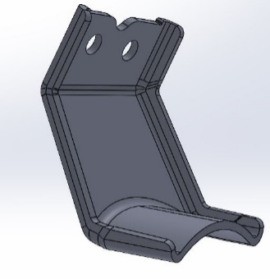
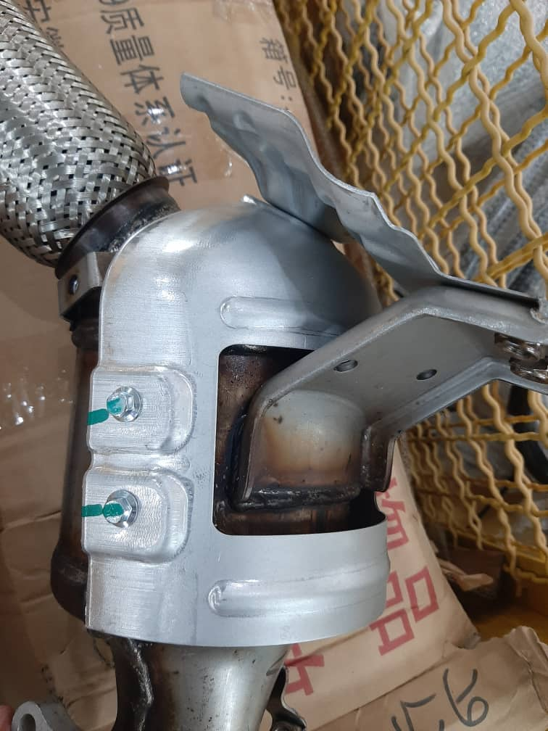
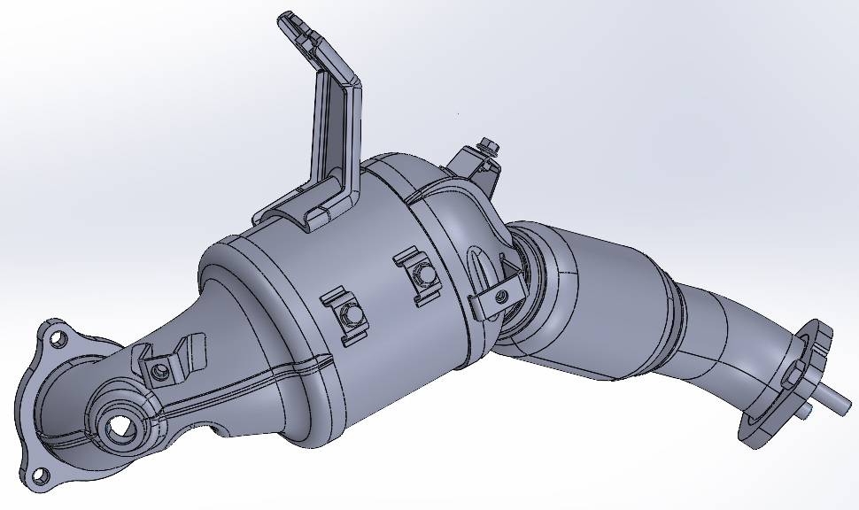
Material Changes
Material benchmark in other catalytic converter
Material benchmark of brackets according to Tiara Catalytic Converter (Baic X5) due to the same condition.
AISI 430,Din 1.4016,T=4mm- EN10088-2
Tiara Catalytic Converter
6

Slide 8
Material Changes
Comparison mechanical and chemical characteristics between stainless steel SUS 410 and SUS 304L
Comparison chemical characteristics
Grade | C | Si | Mn | P | S | Cr
SUS 410(1.4006) | 0.08 to 0.15 | 1 | 1.5 | 0.04 | 0.015 | 11.5 to 13.5
SUS 304(1.4307) | 0.03 | 1 | 2 | 0.045 | 0.015 | 17.5 to 19.5
According to EN10088-2 standard
Regarding to position of intake flange and chemical characteristics which you can find in the upper table, the Chromium ingredient of SUS304L is bigger than SUS410. In this way, the SUS304L has better corrosion and heat resistance.
7

Slide 9
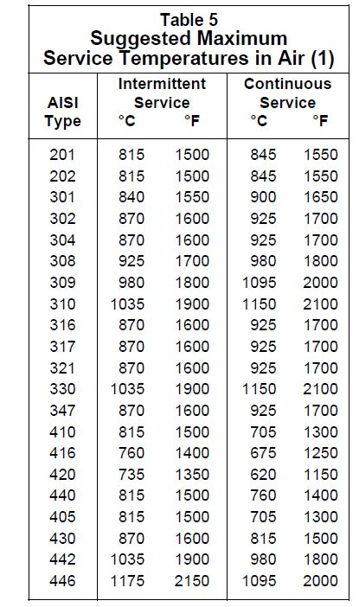
Material Changes
Comparison mechanical and chemical characteristics between stainless steel SUS 410 and SUS 304L
Comparison chemical characteristics
According to upper chart, the SUS304L can resist higher temperature in comparison with SUS410
8

Slide 10
Material Changes
Comparison mechanical and chemical characteristics between stainless steel SUS 410 and SUS 304L
Comparison mechanical characteristics
Grade | Tensile Strength (Mpa) | %Elongation
410 | Max 600 | 20
304L | 520 to 700 | 45
According to EN10088-2 standard
Conclusion of consideration chemical and mechanical characteristics
In conclusion, that is obvious the SUS304L has a better chemical and mechanical characteristics in comparison with SUS410, and also it is more expensive than SUS410. By the way, at this time, purchasing that specific material, it is unreachable for Iran Delco Co.
9

Slide 11
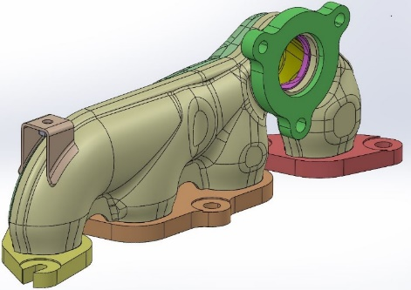
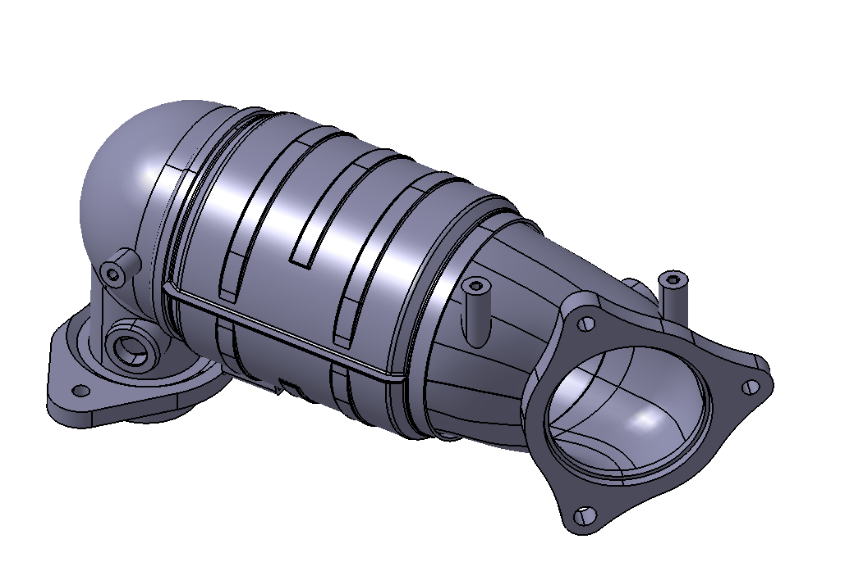
Material Changes
Material benchmark in other catalytic converter
Material benchmark of Intake Flange according to EF7 TC Manifold (IKCO-FEV design) and Shahin Catalytic Converter (Saipa Company) due to the same condition.
EF7 TC Manifold
Shahin Catalytic Converter
10

Slide 12
Planning
نوار زمان پروژه
Summary planning of whole set of Fidelity Prime Catalytic Converter
Summary planning of whole set of Fidelity Prime Catalytic Converter
Part Name | First off tool sample | First Off Process
Pre Catalyst ASSY | 27-Apr-2024 | 02-July-2024
Pipe Down ASSY | 24-Feb-2024 | 22-Jun-2024
Main Catalyst Converter and Front Muffler ASSY | 13-Mar-2024 | 25-Jun-2024
11

Slide 13
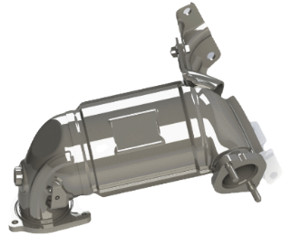
Planning
نوار زمان پروژه
Pre Catalyst ASSY planning by the detail
Φ105.7x152.4 600CPSI,3Mil
Prototype sample and replacement in CKD
The end of manufacturing
mold
MOM with customer
First off process
Preparation of price analysis
The end of manufacturing
production fixtures
First off tool sample
Set the order for substrate
Jun
July
August
September
October
November
December
January
February
March
April
May
Jun
July
August
The end of manufacturing
checking fixtures
Inquiry from Supplier
Receive technical documents
Receiving the substrate cargo
Starting the catalyst equipment
Catalyst destruction and extraction
Receiving the sample of substrate
Sop
2023-2024
12

Slide 14
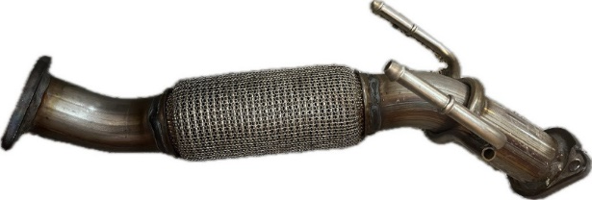
Prototype sample and replacement in CKD
The end of manufacturing mold
The end of manufacturing production fixtures
First off process
The end of manufacturing checking fixtures
Receiving the substrate cargo
2023-2024
Catalyst destruction and extraction
Planning
نوار زمان پروژه
Pipe Down ASSY planning by the detail
First off tool sample
MOM with customer
The end of manufacturing production fixtures
Preparation of price analysis
First off process
Set the order for Flexible
Jun
July
August
September
October
November
December
January
February
March
April
May
Jun
July
August
Inquiry from Supplier
The end of manufacturing checking fixtures
Receive technical documents
Receiving the substrate cargo
Starting the catalyst equipment
2023-2024
13

Slide 15
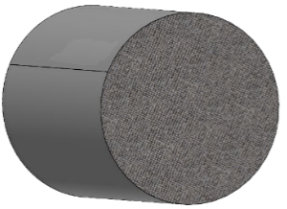
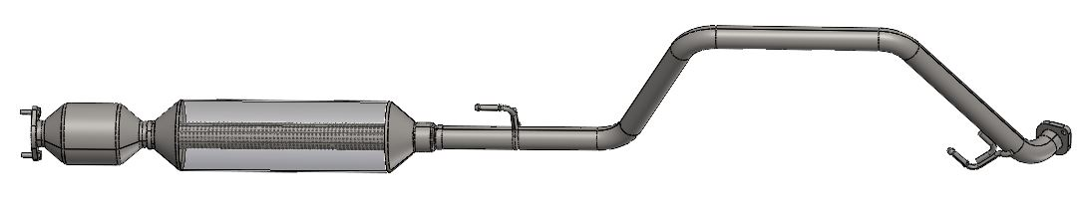
Planning
نوار زمان پروژه
Main Catalyst Converter and Front Muffler ASSY planning by the detail
Φ118.4x100
400CPSi,6Mil
Prototype sample and replacement in CKD
The end of manufacturing mold
MOM with customer
The end of manufacturing production fixtures
Preparation of price analysis
First off process
Set the order for substrate
Jun
July
August
September
October
November
December
January
February
March
April
May
Jun
July
August
First off tool sample
The end of manufacturing checking fixtures
Inquiry from Supplier
Receiving the substrate cargo
Receive technical documents
2023-2024
Starting the catalyst equipment
Catalyst destruction and extraction
Receiving the sample of substrate
14

